Slide 1
Merge SORT

Slide 2
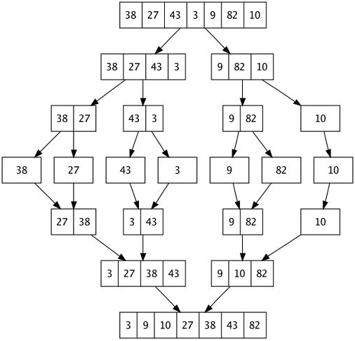
Execution Sequence
void Merge_sort(int from, int to){
if(from >=to) return;
m = (from + to)/2;
Merge_sort(from, m);
Merge_sort(m+1, to);
Merge(from, m, to);
}

Slide 3
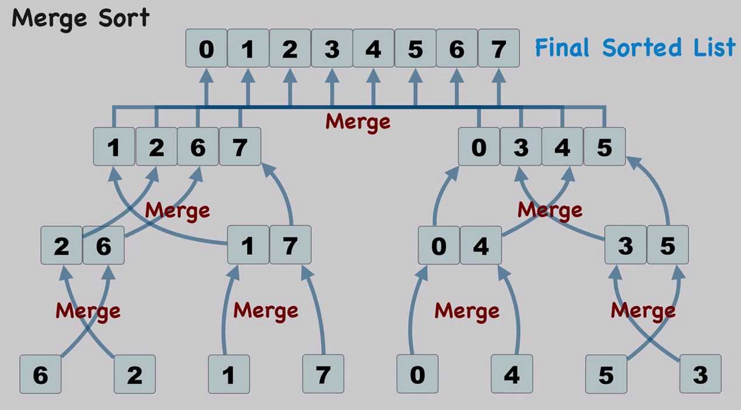
Merge Sort - code
void Merge_sort(int from, int to)
{
if(from >=to) return;
m = (from + to)/2;
Merge_sort(from, m);
Merge_sort(m+1, to);
Merge(from, m, to);
}

Slide 4
Merging (cont.)
X:
3 | 10 | 23 | 54
Y:
1 | 5 | 25 | 75
Result:

Slide 5
Merging (cont.)
X:
3 | 10 | 23 | 54
Y:
 | 5 | 25 | 75
Result:
1

Slide 6
Merging (cont.)
X:
 | 10 | 23 | 54
Y:
 | 5 | 25 | 75
Result:
1 | 3

Slide 7
Merging (cont.)
X:
 | 10 | 23 | 54
Y:
 |  | 25 | 75
Result:
1 | 3 | 5

Slide 8
Merging (cont.)
X:
 |  | 23 | 54
Y:
 |  | 25 | 75
Result:
1 | 3 | 5 | 10

Slide 9
Merging (cont.)
X:
 |  |  | 54
Y:
 |  | 25 | 75
Result:
1 | 3 | 5 | 10 | 23

Slide 10
Merging (cont.)
X:
 |  |  | 54
Y:
 |  |  | 75
Result:
1 | 3 | 5 | 10 | 23 | 25

Slide 11
Merging (cont.)
X:
Y:
 |  |  | 75
Result:
1 | 3 | 5 | 10 | 23 | 25 | 54

Slide 12
Merging (cont.)
X:
Y:
Result:
1 | 3 | 5 | 10 | 23 | 25 | 54 | 75

Slide 13
Merge Sort
분할 과정
def merge_sort(m):
if len(m) <= 1 : # 사이즈가 0이거나 1인 경우, 바로 리턴
return m
# 1. DIVIDE 부분
mid = len(m) // 2
left = m[:mid]
right = m[mid:]
# 리스트의 크기가 1이 될 때까지 merge_sort 재귀 호출
left = merge_sort(left)
right = merge_sort(right)
# 2. CONQUER 부분 : 분할된 리스트들 병합
return merge(left, right)

Slide 14



Merge Sort
3 27 38 43
def merge(left, right):
result = [] #두 개의 분할된 리스트를 병합하여 result를 만듦
while len(left) > 0 and len(right) > 0 :
# 양쪽 리스트에 원소가 남아있는 경우
# 두 서브 리스트의 첫 원소들을 비교하여 작은 것부터 result에 추가함
if left[0] <= right[0] :
result.append(left.pop(0))
else :
result.append(right.pop(0))
if len(left) > 0 : # 왼쪽 리스트에 원소가 남아있는 경우
result.extend(left)
if len(right) > 0 : # 오른쪽 리스트에 원소가 남아있는 경우
result.extend(right)
return result
T(n) = θ(n)
3
9 10 82
27 38 43
9
9 10 82
27 38 43
10
10 82
27 38 43
27
82
38 43
38
82

Slide 15
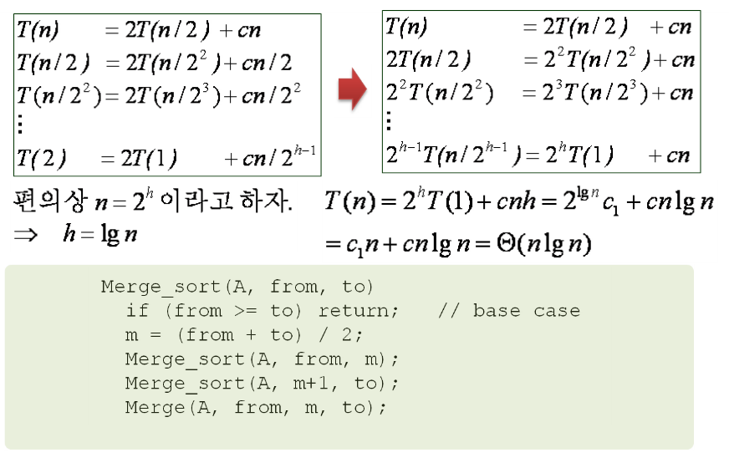
Merge Sort - 성능

Slide 16
MergeSort

Slide 17
38 | 27 | 43 | 3 | 9 | 82 | 10
0 | 1 | 2 | 3 | 4 | 5 | 6
27
1
m
to | 1
From | 1
R.A | Line 12
9 return
11: Merge_sort(1,1)
38 | 27 | 43 | 3
0 | 1 | 2 | 3
38 | 27
0 | 1
38
0
m | 3
to | 6
From | 0
R.A
m | 1
to | 3
From | 0
R.A | Line 12
m | 0
to | 1
From | 0
R.A | Line 12
m
to | 0
From | 0
R.A | Line 12
12 Merge_sort(1,1)
11 Merge_sort(0,3)
11 Merge_sort(0,1)
11 Merge_sort(0,0)
9 return
Merge_sort(0,6)
11: Merge_sort(0,3)
11: Merge_sort(0,1)
11: Merge_sort(0,0)

Slide 18
38 | 27 | 43 | 3 | 9 | 82 | 10
0 | 1 | 2 | 3 | 4 | 5 | 6
38 | 27
0 | 1
to | 3
m | 1
From | 0
R.A | Line 14
LEFT
38 | 0x7ffffff
RIGHT
27 | 0x7ffffff
13: Merge(0,1,3)
38 | 27 | 43 | 3
0 | 1 | 2 | 3
38 | 27
0 | 1
27 | 38
0 | 1
m | 3
to | 6
From | 0
R.A
m | 1
to | 3
From | 0
R.A | Line 12
13 Merge(0,1,3)
m | 1
to | 3
From | 0
R.A | Line 12
12 Merge_sort(2,3)
12 Merge_sort(1,1)
11 Merge_sort(0,3)
11 Merge_sort(0,1)
11 Merge_sort(0,0)
Merge_sort(0,6)
11: Merge_sort(0,3)
11: Merge_sort(0,1)

Slide 19
38 | 27 | 43 | 3 | 9 | 82 | 10
0 | 1 | 2 | 3 | 4 | 5 | 6
38 | 27 | 43 | 3
0 | 1 | 2 | 3
38 | 27
0 | 1
27 | 38
0 | 1
m | 3
to | 6
From | 0
R.A
m | 1
to | 3
From | 0
R.A | Line 12
12 Merge_sort(2,3)
11 Merge_sort(0,3)
11 Merge_sort(0,1)
Merge_sort(0,6)
11: Merge_sort(0,3)

Slide 20
Execution Example
Partition
7 2 9 4 ⏐ 3 8 6 1

Slide 21
Execution Example (cont.)
Recursive call, partition
7 2 9 4 ⏐ 3 8 6 1
7 2 ⏐ 9 4

Slide 22
Execution Example (cont.)
Recursive call, partition
7 2 9 4 ⏐ 3 8 6 1
7 2 ⏐ 9 4
7 ⏐ 2

Slide 23
Execution Example (cont.)
Recursive call, base case
7 2 9 4 ⏐ 3 8 6 1
7 2 ⏐ 9 4
7 ⏐ 2
7 → 7

Slide 24
Execution Example (cont.)
Recursive call, base case
7 2 9 4 ⏐ 3 8 6 1
7 2 ⏐ 9 4
7 ⏐ 2
7 → 7
2 → 2

Slide 25
Execution Example (cont.)
Merge
7 2 9 4 ⏐ 3 8 6 1
7 2 ⏐ 9 4
7 ⏐ 2 → 2 7
7 → 7
2 → 2

Slide 26
Execution Example (cont.)
Recursive call, …, base case, merge
7 2 9 4 ⏐ 3 8 6 1
7 2 ⏐ 9 4
7 ⏐ 2 → 2 7
9 4 → 4 9
7 → 7
2 → 2
9 → 9
4 → 4

Slide 27
Execution Example (cont.)
Merge
7 2 9 4 ⏐ 3 8 6 1
7 2 ⏐ 9 4 → 2 4 7 9
7 ⏐ 2 → 2 7
9 4 → 4 9
7 → 7
2 → 2
9 → 9
4 → 4

Slide 28
Execution Example (cont.)
Recursive call, …, merge, merge
7 2 9 4 ⏐ 3 8 6 1
7 2 ⏐ 9 4 → 2 4 7 9
3 8 6 1 → 1 3 6 8
7 ⏐ 2 → 2 7
9 4 → 4 9
3 8 → 3 8
6 1 → 1 6
7 → 7
2 → 2
9 → 9
4 → 4
3 → 3
8 → 8
6 → 6
1 → 1

Slide 29
Execution Example (cont.)
Merge
7 2 9 4 ⏐ 3 8 6 1 → 1 2 3 4 6 7 8 9
7 2 ⏐ 9 4 → 2 4 7 9
3 8 6 1 → 1 3 6 8
7 ⏐ 2 → 2 7
9 4 → 4 9
3 8 → 3 8
6 1 → 1 6
7 → 7
2 → 2
9 → 9
4 → 4
3 → 3
8 → 8
6 → 6
1 → 1

Slide 30
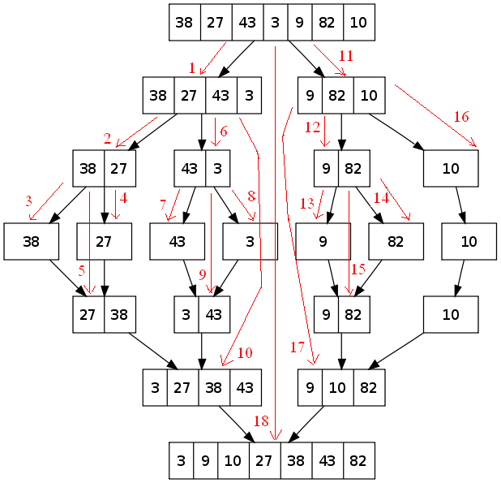

Slide 31
Recursion Tree

Slide 32
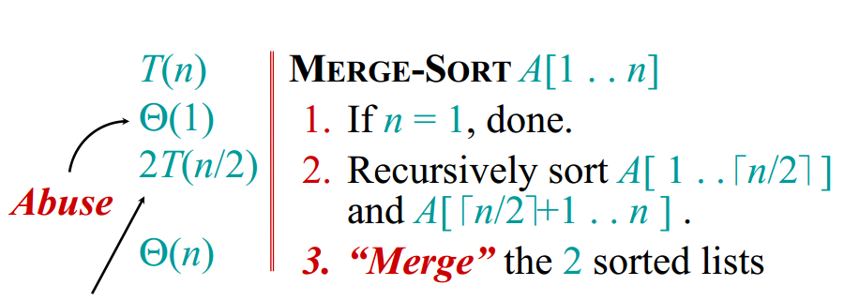
Merge Sort

Slide 33
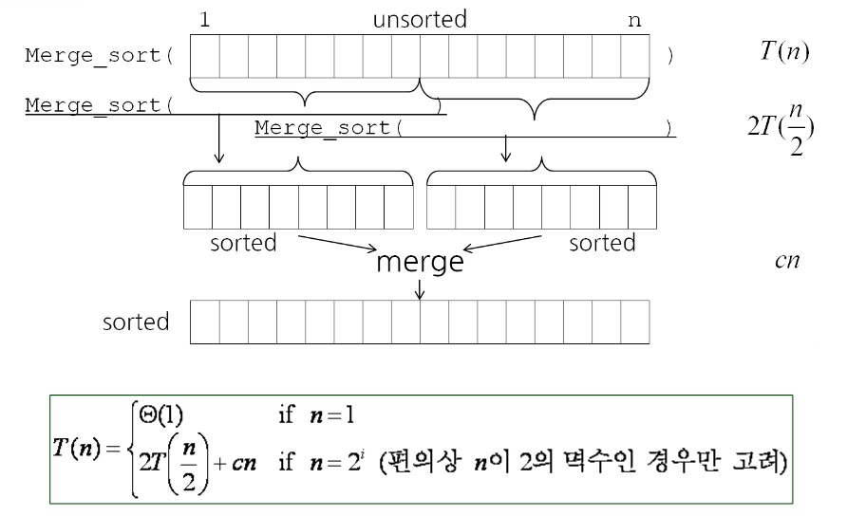
Merge Sort

Slide 34
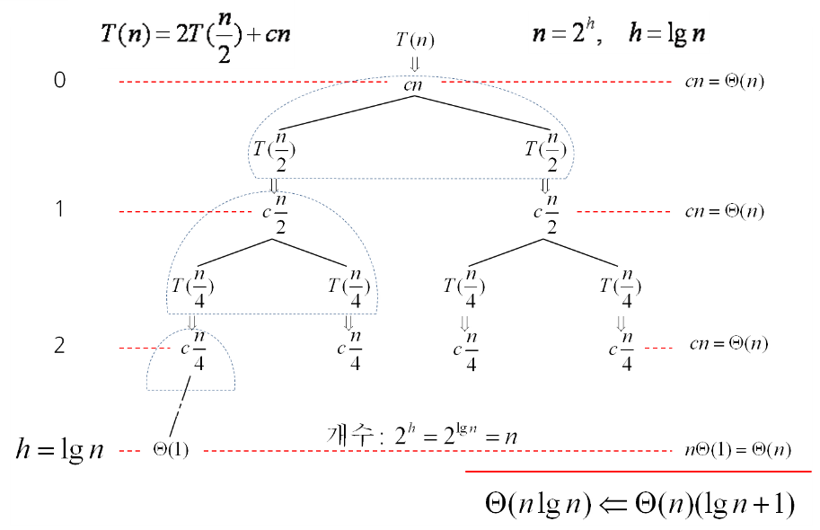
Merge Sort Recursion Tree

Slide 35
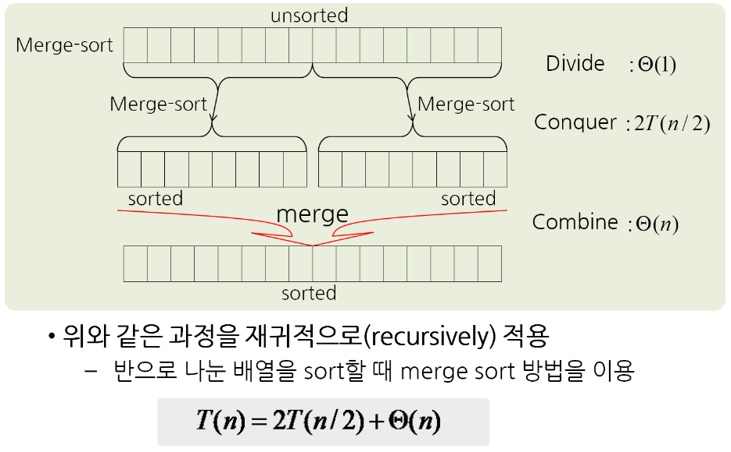
Merge Sort 방법

Slide 36

Exercise 2
Implement Merge Sort Algorithm
Example
11, 45, 23, 81, 28, 34
11, 45, 22, 81, 23, 34, 99, 22, 17, 8
1, 1, 1, 1, 1, 0, 0, 0, 0, 0
Notes:
#include <stdio.h>
void main(void)
{
int arr[10] = {-1, 3, -9, 6, 7, -6, 1, 5, 4, -2};
int sum=0;
for(int i=0;i<(1<<10);i++)
{
sum=0;
for(int j=0;j<10;j++)
if(i&(1<<j)) sum+= arr[j];
if(sum ==0)
{
for(int j=0;j<10;j++)
if(i&(1<<j)) printf("%d, ", arr[j]);
printf("\n");
}
}
}

Slide 37
Insertion Sort

Slide 38
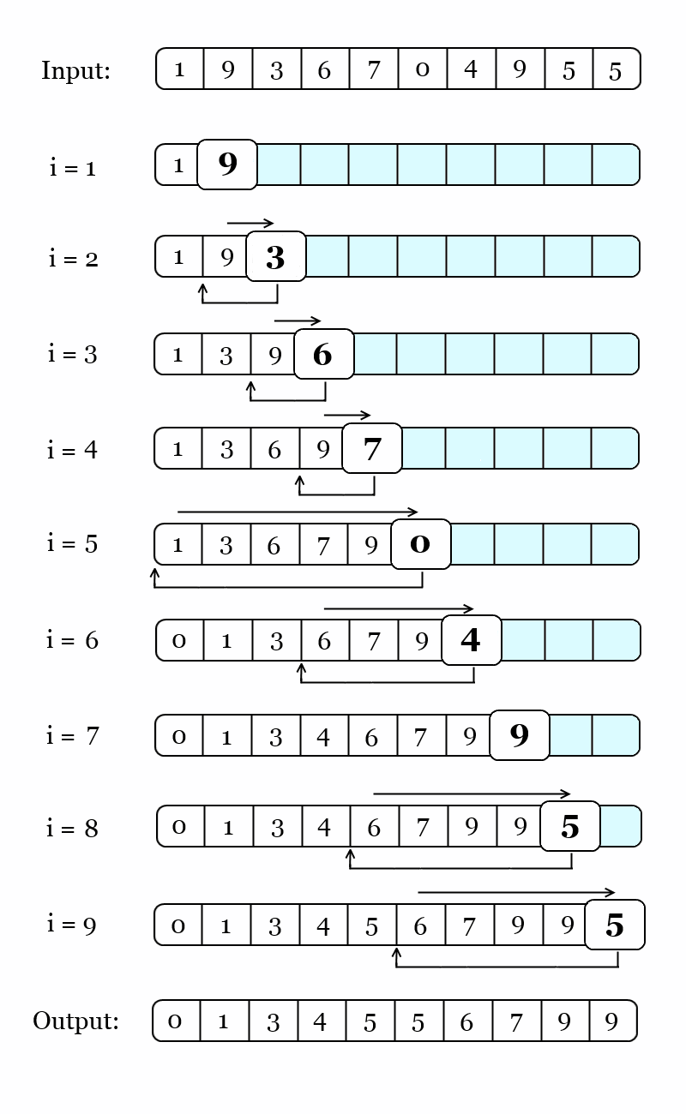
Insertion Sort

Slide 39
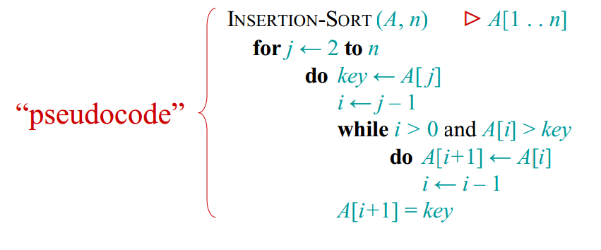
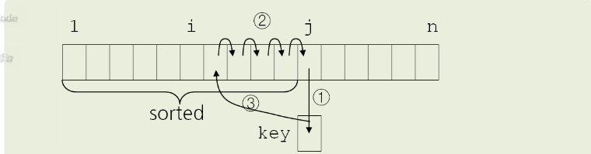
Insertion Sort

Slide 40
Insertion Sort
Worst-case(Input : 9 7 6 5 4 2) : Always
2
T(n) = 1+2+···+(n-2)+(n-1) = (n-1)n/2 = Θ(n )
Best-case(Input : 2 4 5 6 7 9) – Bogus!!
T(n) = 1+1+···+1 = n-1 = Θ(n)
Average-case - Sometimes
T(n) = (1+2+···+(n-1))/2 = (n-1)n/4 = Θ(n )
2
Notes:
void Insertion_Sort()
{
for(int i = 1; i < 5; i++)
{
int key = data[i];
int j = i - 1 ;
while (j >=0 && data[j] > key)
{
data[j+1] = data[j];
j--;
}
data[j+1] = key;
}
}

